Slide 1
Introduction to FHIR
(Fast Health Interoperable Resources)
Grahame Grieve
Aug 26, 2014
Licensed Under Creative Commons (CC-BY)

Slide 2
What is FHIR?
A set of modular components called “Resources”
Resources refer to each other using URLs
Build a web to support healthcare process
Exchange resources between systems
Using a RESTful API (e.g. web approach)
As a bundle of resources (messages, documents)

Slide 3
Genesis of FHIR
HL7 not keeping up with pace of change?
V2 Old, and limited by it’s own rules
V3 too slow and too hard
CDA has success, but both limited and too hard
Different contexts of interoperability → different representations that aren’t compatible
Nothing suitable for light-weight integration, or for Health 2.0
No other Organization so well situated

Slide 4
FHIR Manifesto
Focus on Implementers
Target support for common scenarios
Leverage cross-industry web technologies
Require human readability as base level of interoperability
Make content freely available
Support multiple paradigms & architectures
Demonstrate best practice governance
Notes:
We don’t actually have a formal manifesto, but these are the principles we adhere to.

Slide 5
Freely available
Unencumbered – free for use, no membership or attribution required
http://hl7.org/fhir
As of next week:
CC0 “No Rights Reserved” (Public domain)
No restrictions on use/sharing
HL7 protects the trademark, not the copyright
Permission needed to use the name in products
Notes:
Was a bigger deal before HL7 decided to open up all IP
full legal text towards bottom of FHIR home page

Slide 6
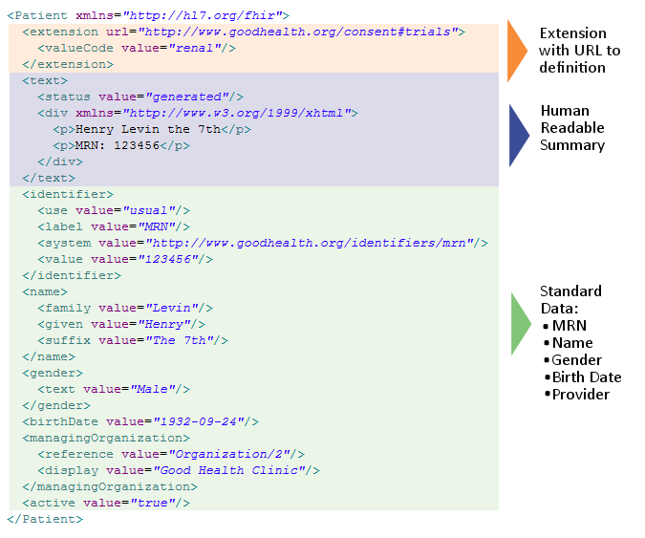
Notes:
System for gender is wrong . . .

Slide 7
Extensions
FHIR has a standard framework for extensions
Every FHIR element can be extended
Every extension has:
Reference to a computable definition
Value – from a set of known types
Every system can read, write, store and exchange all legal extensions
All extensions are valid by schema etc

Slide 8
What’s the goal here?
In most areas of healthcare standards, there is wide variability
Between systems, countries, institutions, clinicians
Choices:
Specification only supports core – no one can use it
Specification adds everything – no one understands it
Specification picks winners – they can use it
Allow extensions that people can use
Extensions tame the specification

Slide 9
Conformance Resources
Conformance – a state of system capabilities
Profile – a set of rules about a resource is used
Value set – describes a set of codes that can be used for something
Concept Map – defines mappings between vocabularies and models
Data Element – formal definition (per 11179)

Slide 10
FHIR is Better
Easy & Quick to understand & implement
Code & example servers already exist
Specification is free for use with no restrictions
Based on the Web
Can be extended and adapted seamlessly for local usage

Slide 11
Overall Progress
Conceived in July 2011
Published FHIR DSTU 1 (“1st BETA”) Jan 2014
Expect to publish next DSTU ~mid 2015
Normative to follow

Slide 12

Where can FHIR be used?
Classic in-institution interoperability
Back-end e-business systems (e.g. financial)
Regional Health Information Organizations (RHIO)
National EHR systems
Social Web (Health)
Mobile Applications
Initial
Focus

Slide 13
Implementer Focus
Specification is written for one target audience: implementers
Rationale, modeling approaches, etc. kept elsewhere
Multiple reference implementations from day 1
Publicly available test servers
Starter APIs published with spec
C#, Java, Pascal, ObjectiveC – more to come
Connectathons to verify specification approaches
Example instances you can read and understand
Public Validation Service
Notes:
Who’s read the v3 spec? – modeler & balloter focused
Spec is driven by people who write code
Numerous pieces have been changed because of experience with what worked when trying to implement
Even have a test workbench for RESTful servers

Slide 14
Servers
Use the servers to explore how it works
Write clients that use the test data
Test that you got your own system right
Most developers:
use the servers to learn
consult the documentation occasionally
(we do recommend to read the specification at least a little)

Slide 15
Other Free software
See http://wiki.hl7.org/index.php?title=Open_Source_FHIR_implementations
Coming shortly:
“Sprinkler” – a conformance test tool for servers
“Forge” – an editor for conformance statements
A Value set Editor
Several implementation guide publishers

Slide 16
Connectathons
Open invitation to any interested party to come and write software that exchanges FHIR resources
Always hold one before HL7 meetings (last week) + Others by invitation
Mix of skills
Newbies (“where is the spec?”)
Old hands who’ve been to every connectathon
Experiment with new features
We have a virtual connectathon all the time…

Slide 17
Architecture Options
Standalone FHIR Server
A FHIR Server in front of an existing application (e.g. SQL)
FHIR as front end to an XDS server (“MHD”)
An interface engine that ‘speaks’ FHIR
A tablet/mobile phone application
Web portal uses FHIR to access other systems
A healthcare application that access information from multiple systems as well as it’s own server
Smart-On-FHIR – an EHR plug-in framework

Slide 18
FHIR Manifesto
Focus on Implementers
Target support for common scenarios
Leverage cross-industry web technologies
Require human readability as base level of interoperability
Make content freely available
Support multiple paradigms & architectures
Demonstrate best practice governance

Slide 19
Thank you
FHIR: http://hl7.org/fhir
Development team wiki home: http://wiki.hl7.org/index.php?title=FHIR
Twitter: https://twitter.com/search?q=%23FHIR
Stack Overflow: http://stackoverflow.com/questions/tagged/hl7-fhir

